Slide 1

f
Marketing Scouting with
Facebook Events/Geofencing
Sherry Bowden
Michael Ramsey
June 13, 2019

Slide 2

2018 Joining Study

Slide 3

41
Average Age of New Cub Parents…

Slide 4
Top 3 Reasons They Joined
Develop Character
Learn About Nature & Outdoor Skills
Build Self Confidence

Slide 5
How Did You Hear About Scouting?
24% Flyer at school
26% Family or friends
35% Family member was/is a Scout
10% Saw Cub Scouts Around Town

Slide 6
Why did they leave?
44% Meetings Not Well Organized
27% Poor Leadership
25% Schedule Conflicts
22% Child no longer interested
19% Never contacted

Slide 7
1
No. of times they were asked to join?

Slide 8
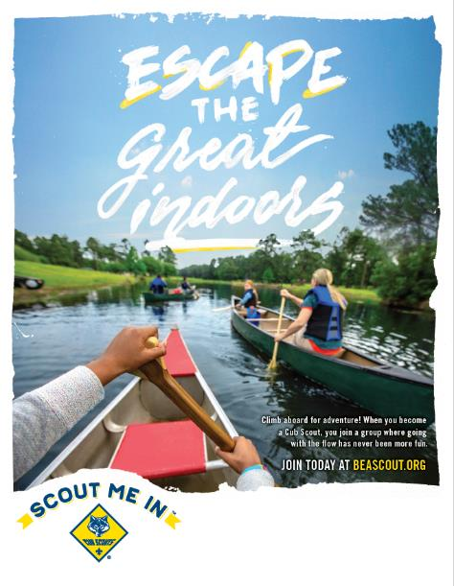
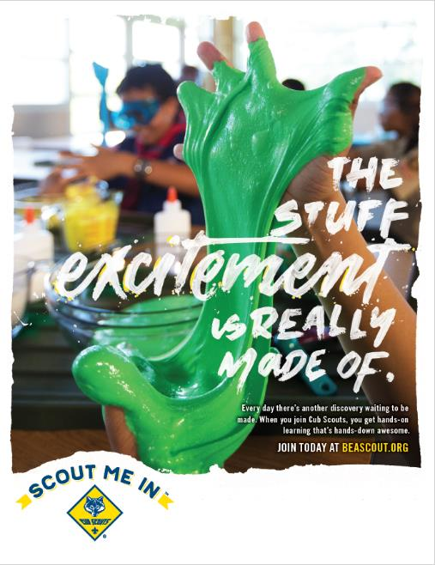
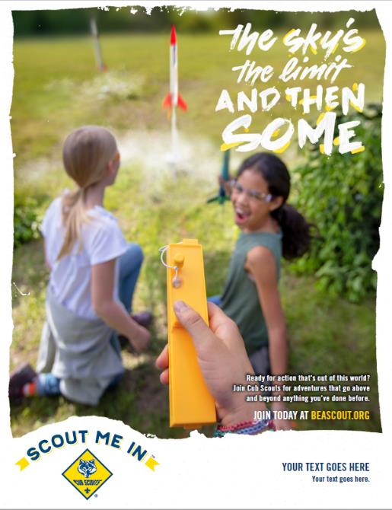

Slide 9
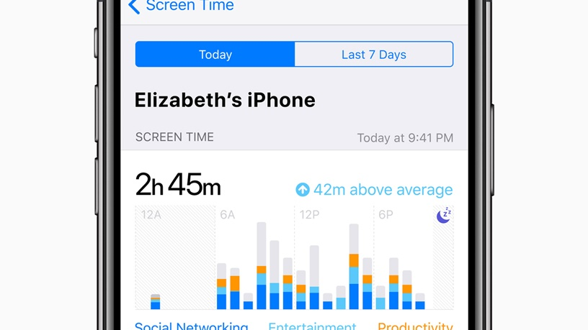

Slide 10

4

Slide 11


It’s where parents are…

Slide 12

Facebook

Slide 13
Two-Thirds (68%) of All Americans are on Facebook

Slide 14
75% visit the site at least once per day.

Slide 15
No other platform comes close in size.
And it’s popular among ALL demographic groups.

Slide 16


43% of Adults Get Their News from Facebook.

Slide 17
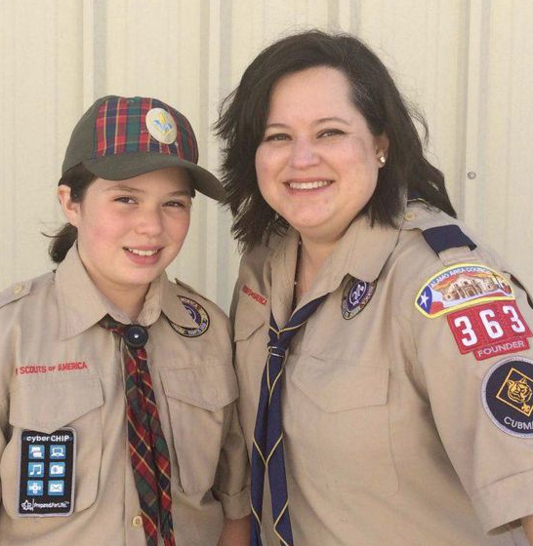
This is Where Our Customers Are
64%
Read online reviews before making a purchase
57%
Have already made up their minds before they go to store make a purchase.
6.3 x
Average number of times Moms check Facebook per day
65%
Learn of a product or service through social media

Slide 18

1.2 Trillion
searches a year

Slide 19
Google owns 63% of the total search market
Google owns 93% of MOBILE search

Slide 20

How do we make this work for Scouting?

Slide 21
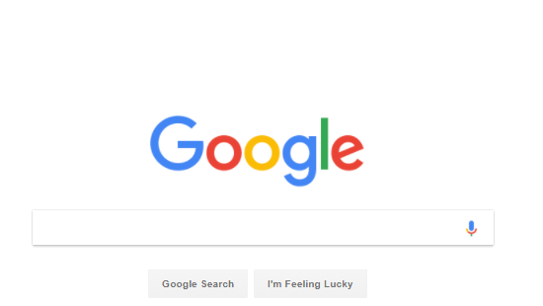

Slide 22
Find ____________________Near Me

Slide 23
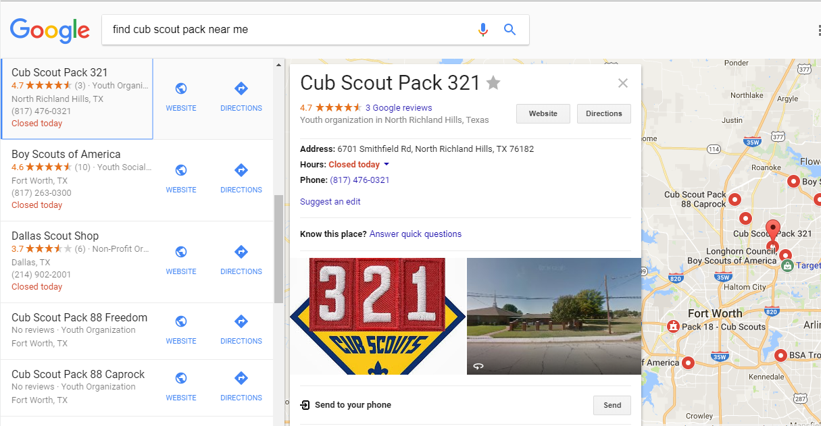
It’s about your phone and the map….
Notes:
I did a search in the Dallas - Ft Worth market…. Here’s what came up…

Slide 24
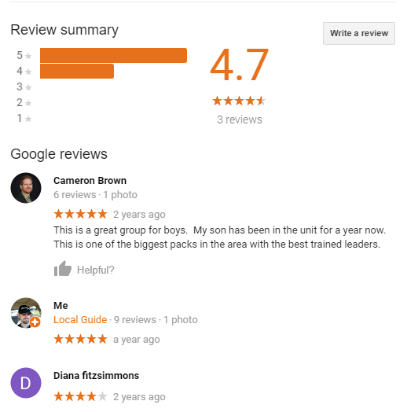
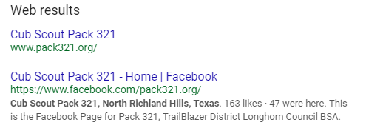

Slide 25
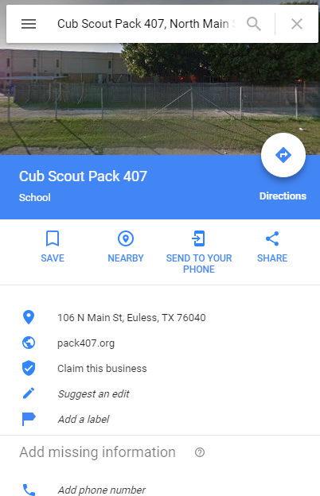
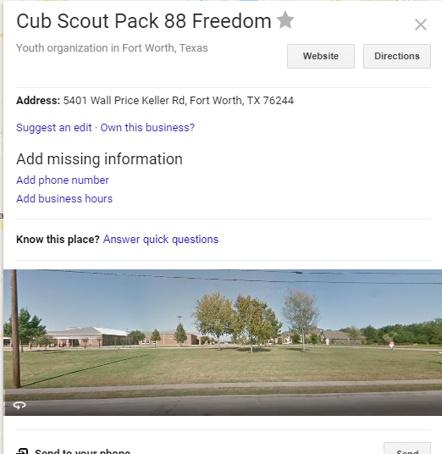
Notes:
Another council that hasn’t claimed and updated their pin vs. Kia Kima….

Slide 27


Facebook Events and Geofencing

Slide 28

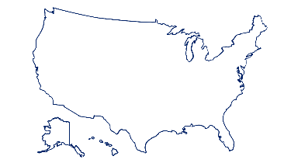
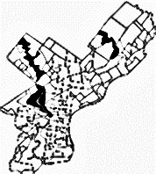
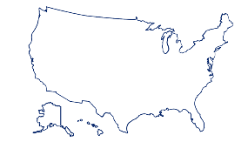
Digital Tactics
SEARCH
NATIONAL LAYER
SOCIAL
LOCAL COUNCIL / MARKET LAYER
GEOFENCING
UNIT / NEIGHBORHOOD LAYER
Stonegate Elementary School

Slide 29
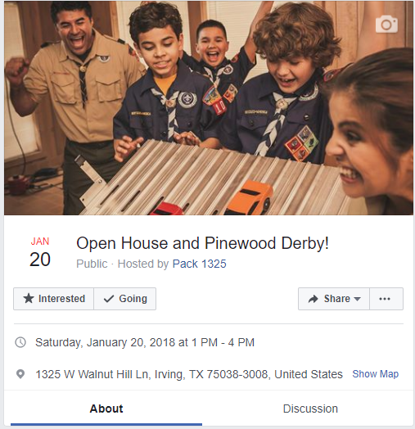
Notes:
Here’s an updated event on the calendar

Slide 30
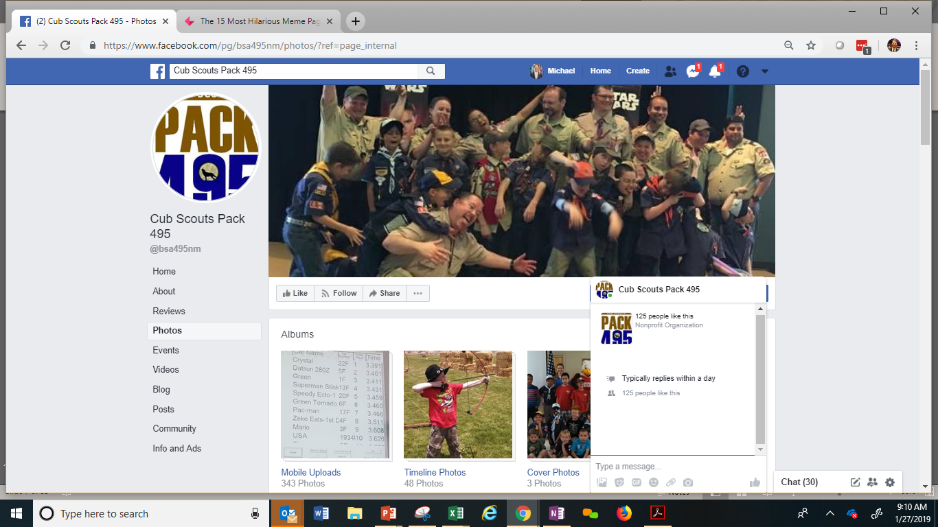

Slide 31
Cub Scouting Media 2018
- 3,119 Geofences
- Across 20 Councils

Slide 32


Geofenced units on average recruited +7.43% MORE new Cub Scouts than they did a year ago.

Slide 33
Non-fenced units within those same councils were DOWN an average of -9.12% in new Cub Scouts recruited.

Slide 34
There was an average 16.55% difference between units that were geofenced, versus those that were not geofenced.

Slide 35
Single-unit events performed better than events with multiple-unit events.
Data also showed that….

Slide 36
Geofenced events held at schools performed the best, followed events in parks and lastly by events at churches.
Data also showed that….

Slide 37

$1 a day per unit

Slide 38
Facebook
Events & Geofencing

Slide 39
It’s simple.

Slide 40
Notes:
There are different types of facebook pages. To create and boost events, you will need an page for an “organization.”

Slide 41
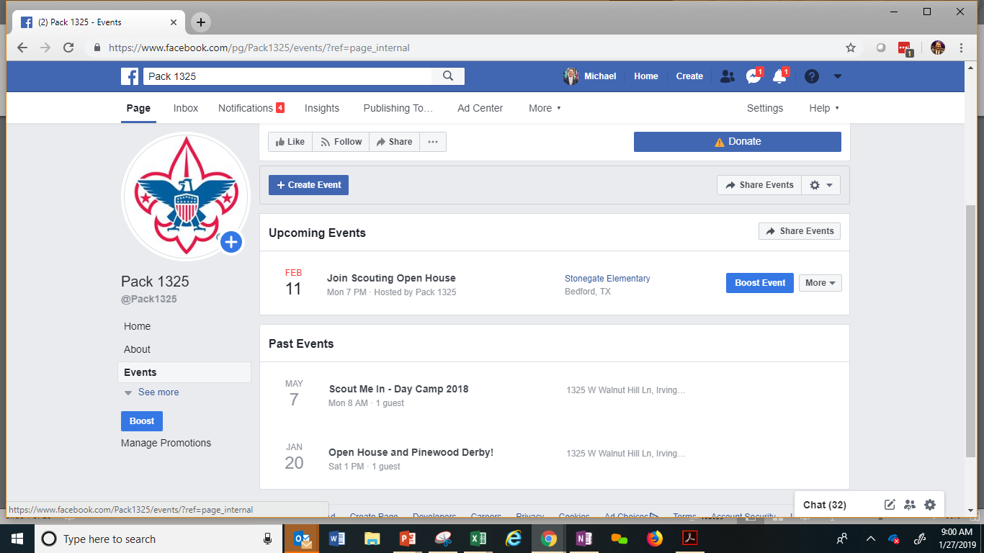
Notes:
This type of page have more tools, such as reviews, a blog and event calendars. Those events are very important, as you’ll see.

Slide 42

Create an Event

Slide 43
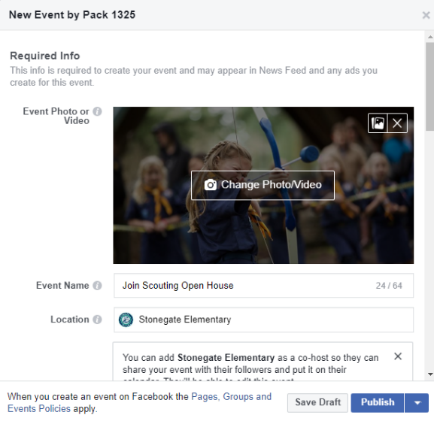
Notes:
Select “Events” and create a new event.

Slide 44
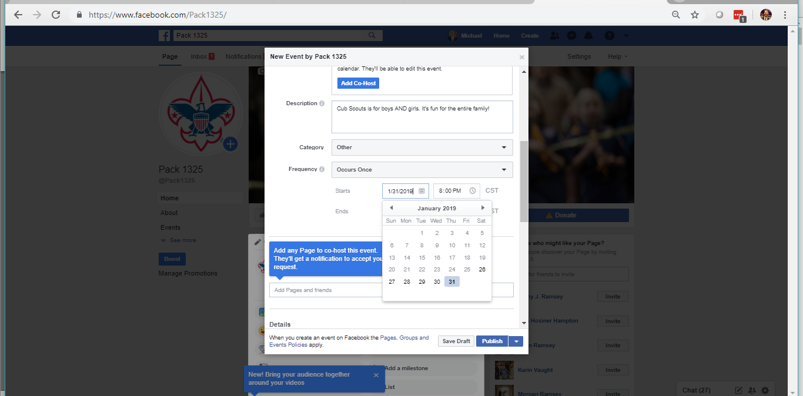
Notes:
In this window you can add a description of your event, set the date and time.

Slide 45
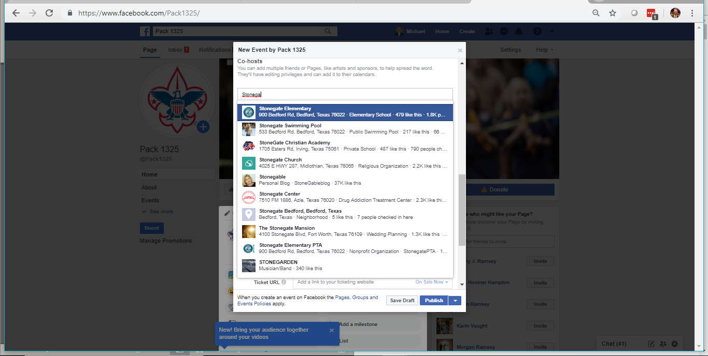
Notes:
Tip: Depending on the type of event, you may decide to ‘co-host’ the event with another organization, such as a school, PTA, PTO, etc. This will increase the number of people who see your event.

Slide 46
Customize Your Event

Slide 47
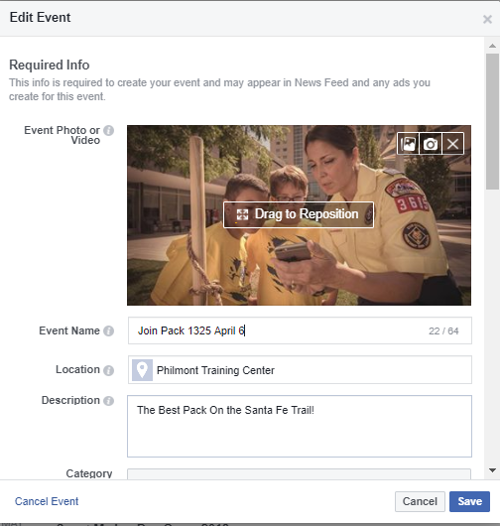
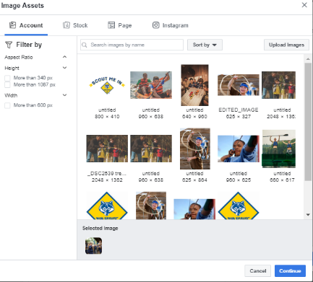
Notes:
In the Boost Event window, you can change the image for the event and add or change the text that will appear in the event posting.

Slide 48
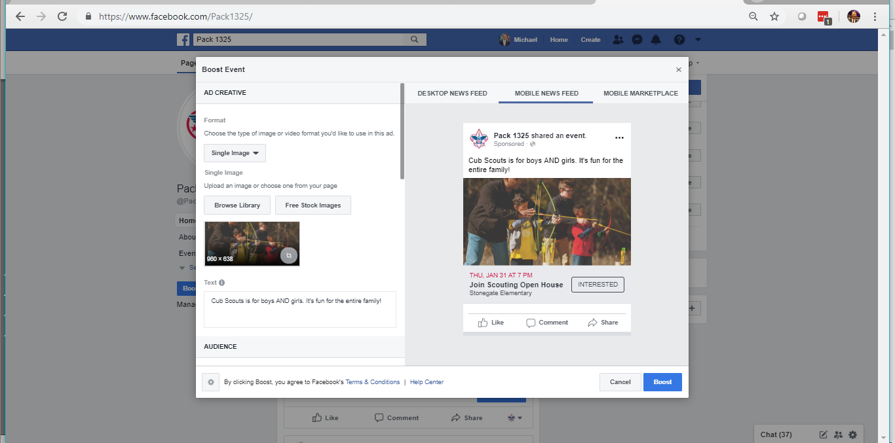

Slide 49
“Boost” the Event

Slide 50
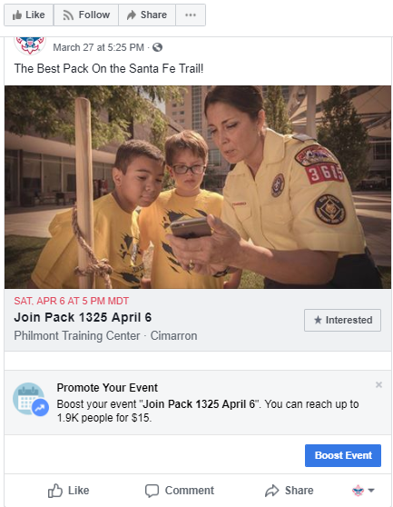
Notes:
Boosting an event means paying to have your event seen by more people in Facebook. This can be for as a little as a dollar a day.
To begin boosting the event, click on the button that says “Boost Event”.

Slide 51
Target Your Audience

Slide 52
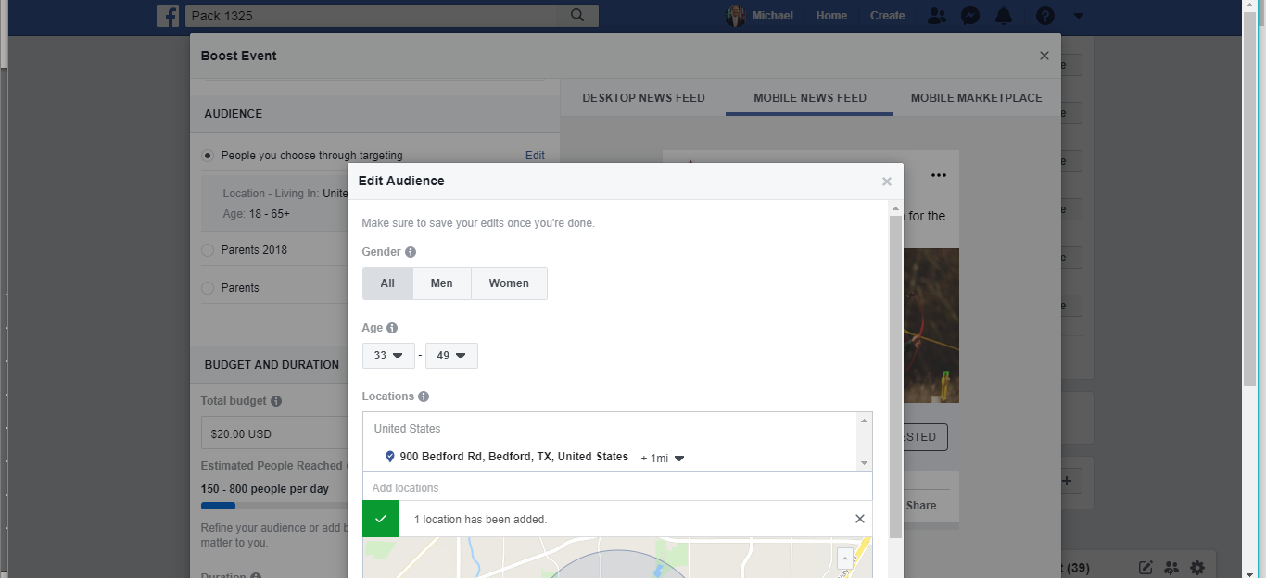

Slide 53
Set the Geofence

Slide 54
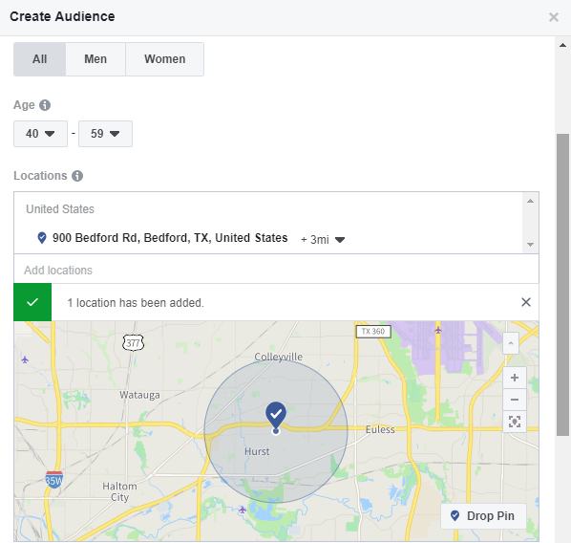

Slide 55
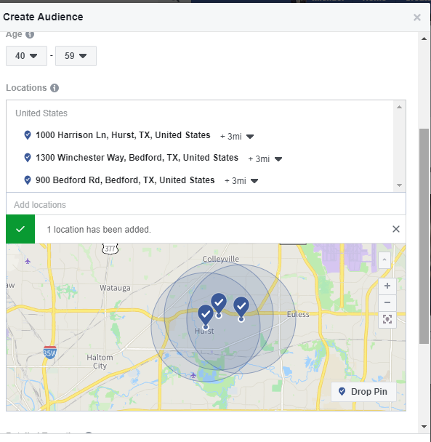

Slide 56
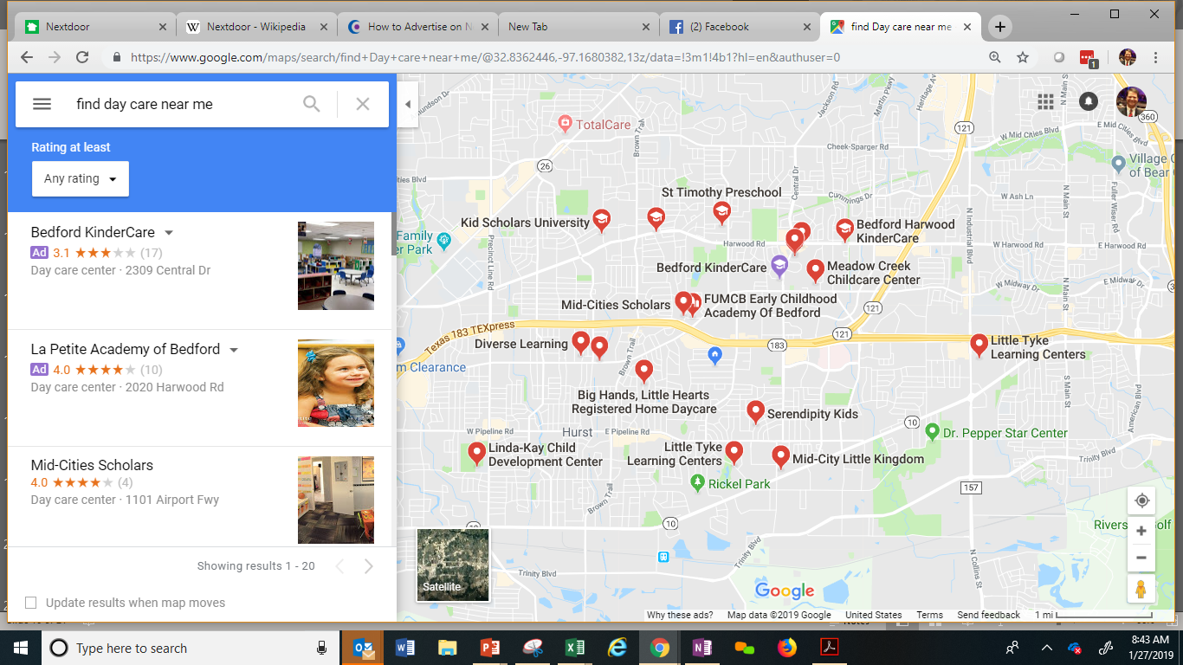

Slide 57

You Can Get Even More Specific on Who Sees Your Event

Slide 58
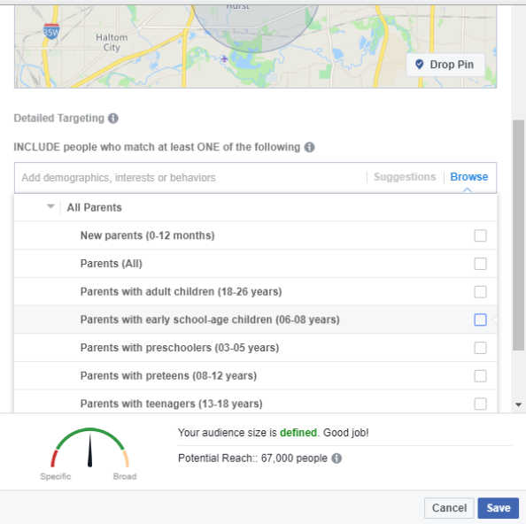

Slide 59
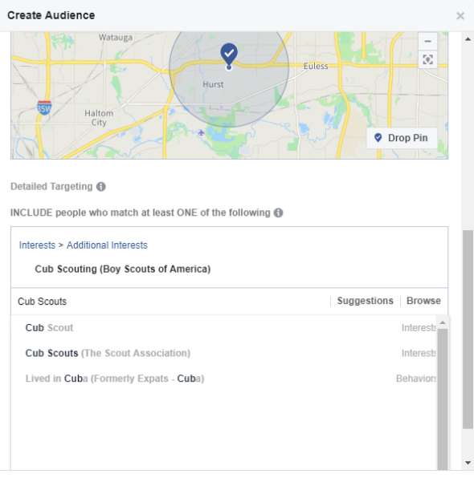

Slide 60
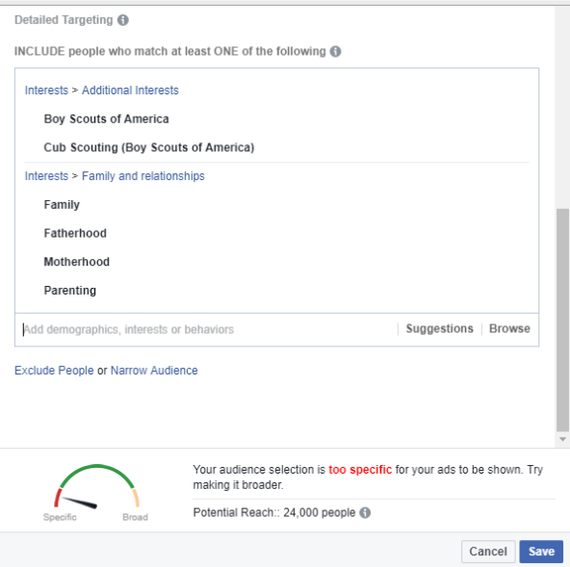
Notes:
Here is an example of a Detailed Targeting. Note that you can so specific, that you rule everyone out in an area. A broad target may be better in some situations.
Bonus tip: More and more grandparents are raising grandchildren. Consider adding them to your target set.

Slide 61
Let’s Talk About $$

Slide 62
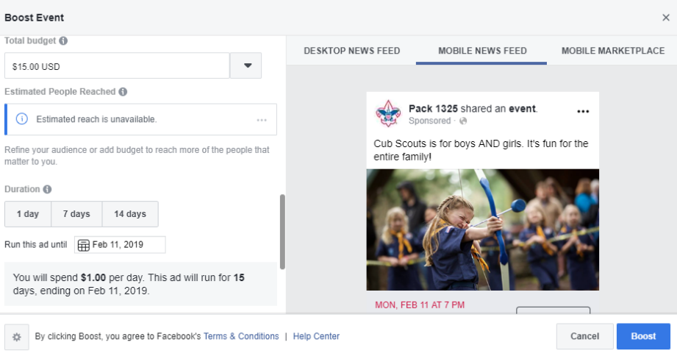

Slide 63
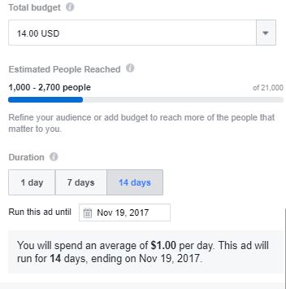
Notes:
Then it asks about money – of course.
To boost an event, you can spend as little as $1 a day. In this scenario, that’s a whopping $14 bucks (lunch at Chick-Fil-a) to reach between 1000 and 2700 people. That’s really good.
You can choose a 1, 7 or 14 day run.
Increasing the budget increases the estimated people reached. (Note: Population density in an area will greatly impact this.)
It’s simple.

Slide 64
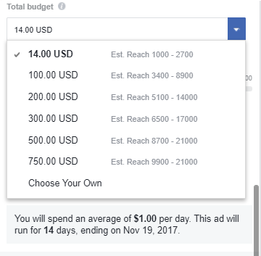
Notes:
And you can spend as much as you like…. Here’s an example in this market.
Of course it will vary by market density and the size of the area you select. (2 mile, 3 mile, 5 mile, etc.)
In our tests, we spent $1 per day, typically from anywhere from 1 week to one month out. One to two weeks out from the joining event seems to be optimal. Most people don’t plan one month in advance.)

Slide 65
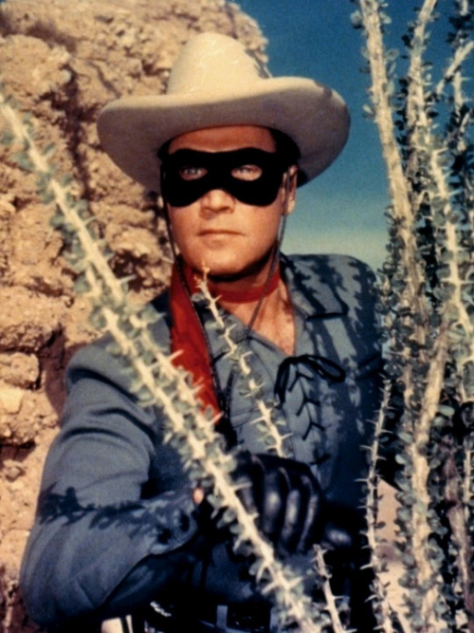
Notes:
There are no silver bullets here! This is one more tactic we can use to reach today’s parents!

Slide 66
Discussion

